Slide 1
INFOLLEGE
Group-19
Team Members -
Aaryaansh Agarwal - 2020003
Deepam Sarmah - 2020050
Ishmeet Singh Saluja - 2020511
Prachi - 2020098
Utkarsh Pal - 2020144

Slide 2
Problem-Solution Statement
What is Problem Statement ?
Problem statement elucidates about the problem which the prototype addresses
Our Problem Statement : Online education in present time is very unorganized/scattered, one needs different platforms/softwares for different tasks.
But what is Solution Statement ?
Solution Statement provides ways through which the product can help users during the problems mentioned in the problem statement.
Our Solution Statement : Infollege provides a variety of features which enables users to get notified before classes and get relevant meeting links

Slide 3
Personas

Slide 4
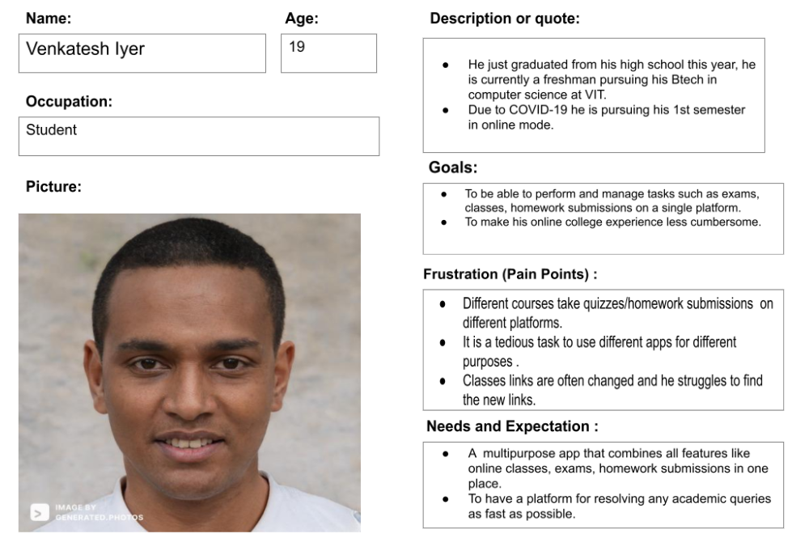

Slide 5
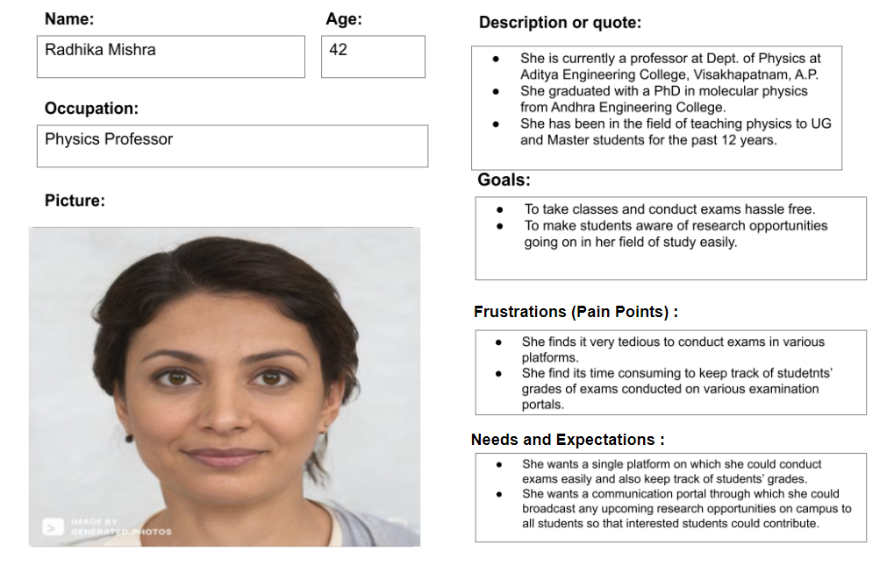

Slide 6
Scenarios

Slide 7
Venkatesh Iyer is an undergraduate student and this is a day in his life.
He wakes up 10 minutes prior to the lecture and realizes he is late
for the class. The ambiguity of the lecture links worries him as there
are sometimes multiple lecture links for the same lecture.
So he wishes that there was some platform through which he could easily get the relevant lecture links easily. After he is done with the lecture he realizes that he has an assignment due in 12 hours and also he is having an examination this evening.
Although he is well prepared, he still needs to re-check the exam and assignment submission platform.
Due to the zillion different exam platforms, he gets quite bewildered and thus is afraid of missing the deadline.

Slide 8
Scenario Mapping

Slide 9
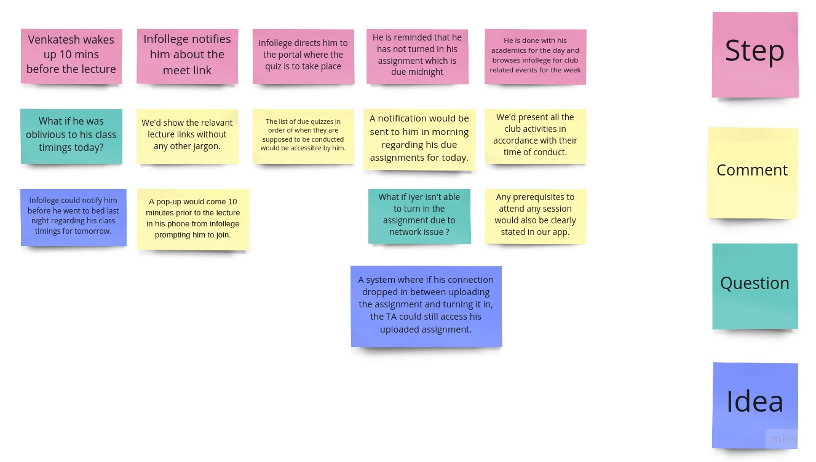

Slide 10
Affinity Diagram

Slide 11
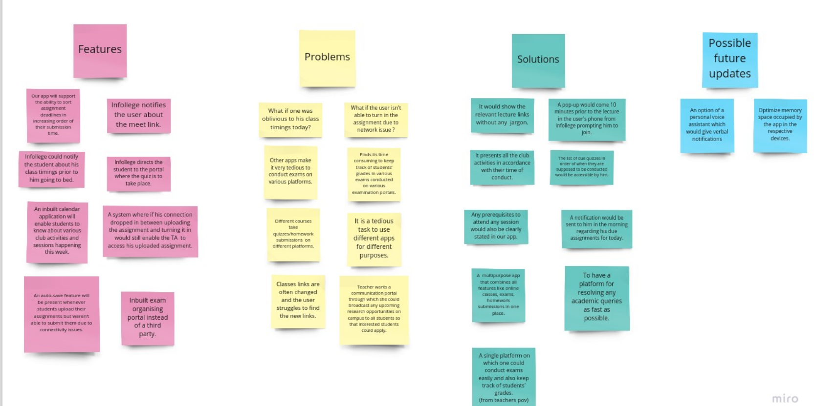

Slide 12
Storyboards

Slide 13
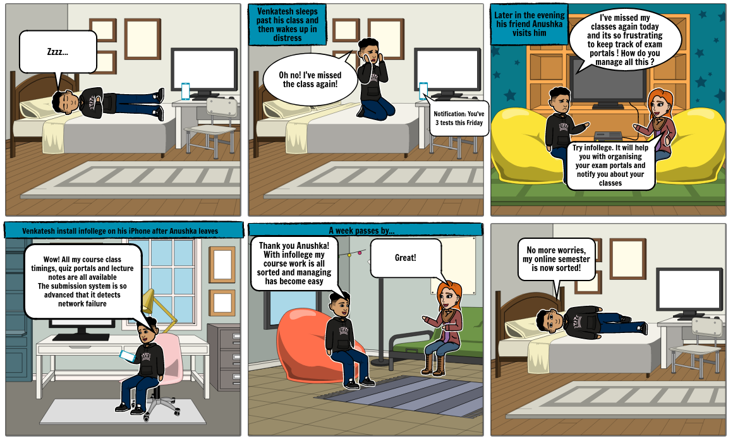

Slide 14
Information Architecture

Slide 15
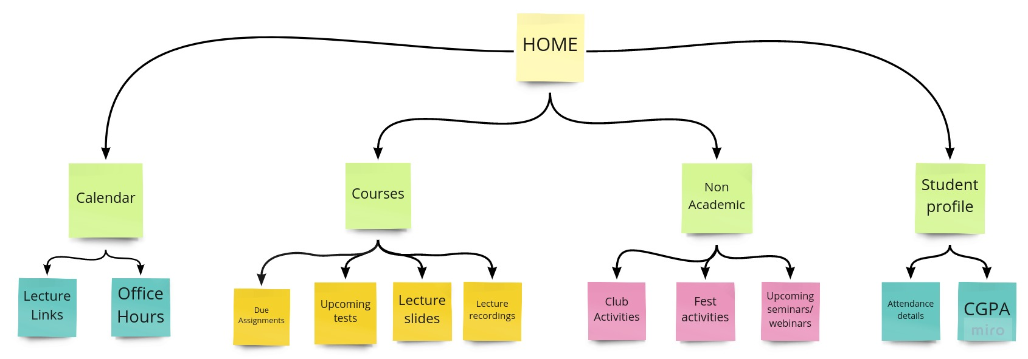

Slide 16
Task flow

Slide 17
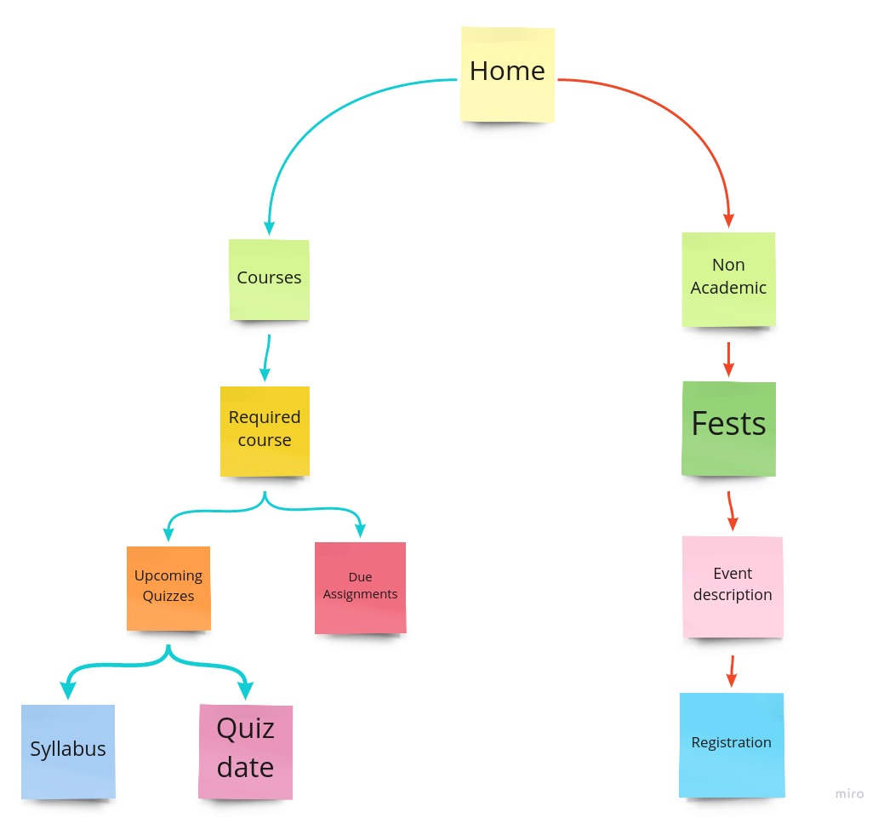

Slide 18
Low-Fidelity Prototype

Slide 19
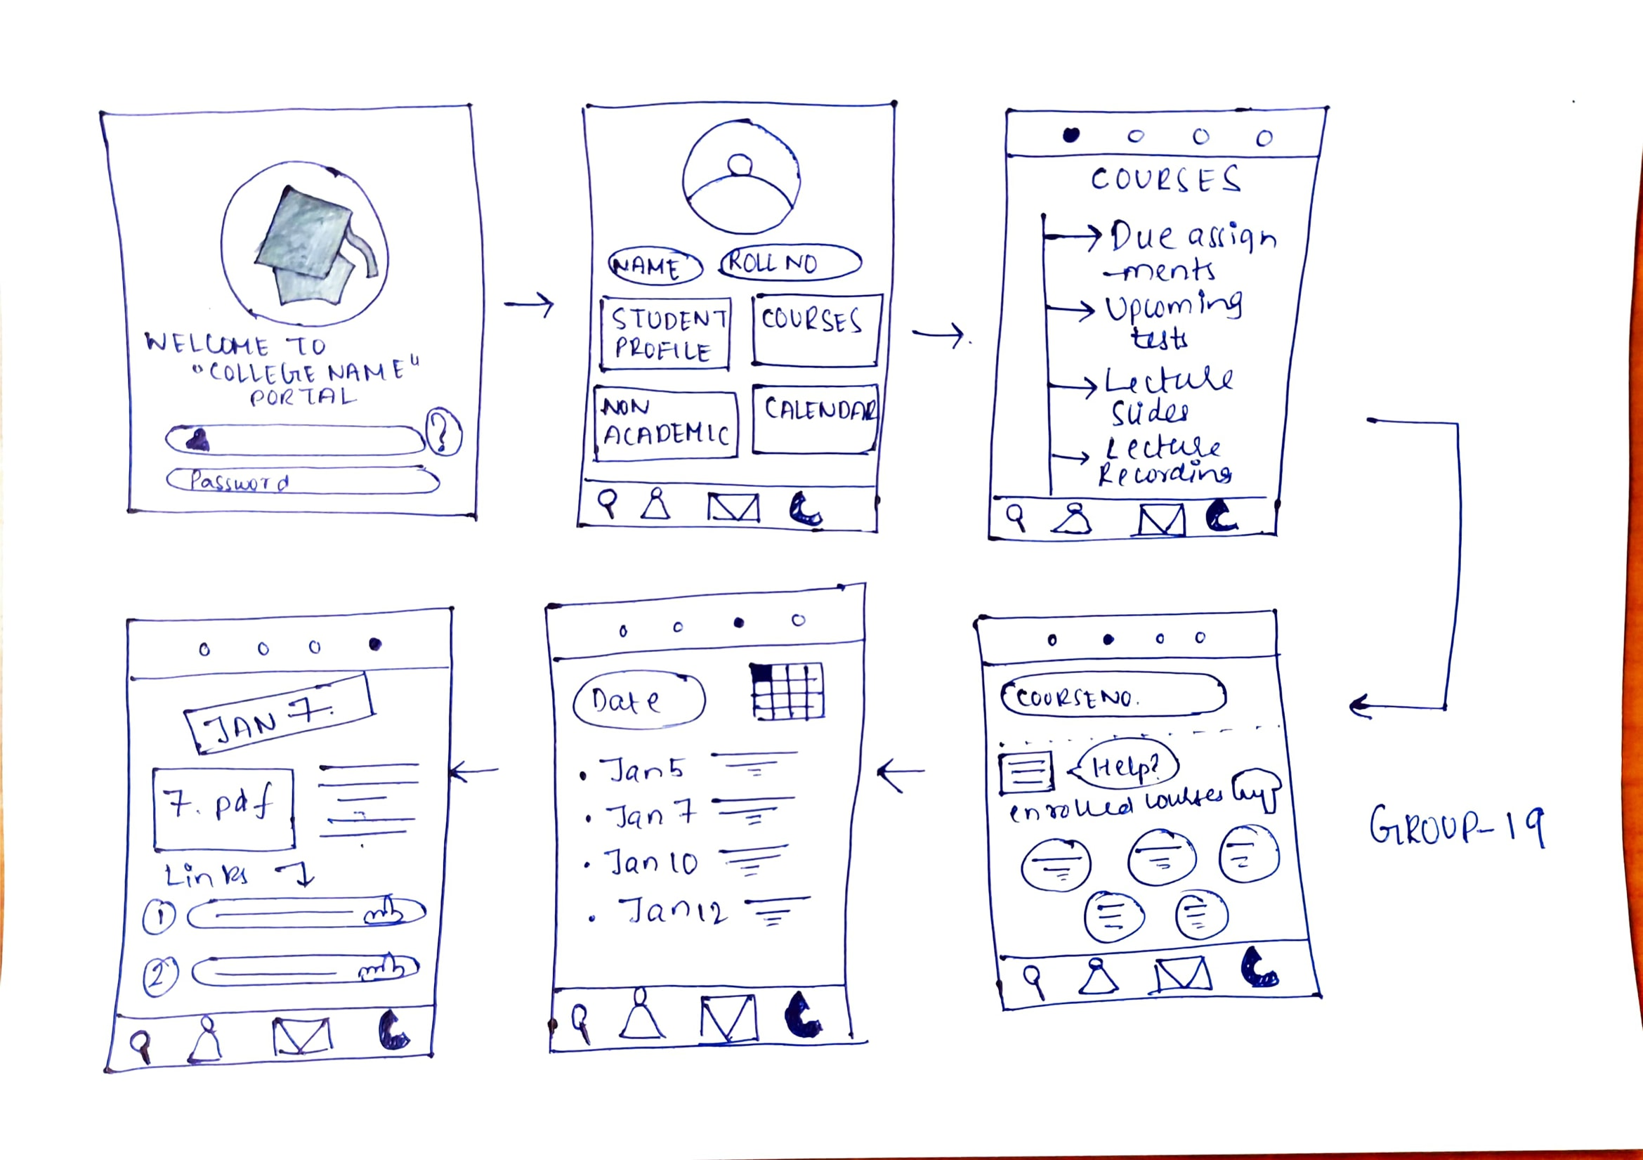

Slide 20
Medium - Fidelity
Prototype

Slide 21
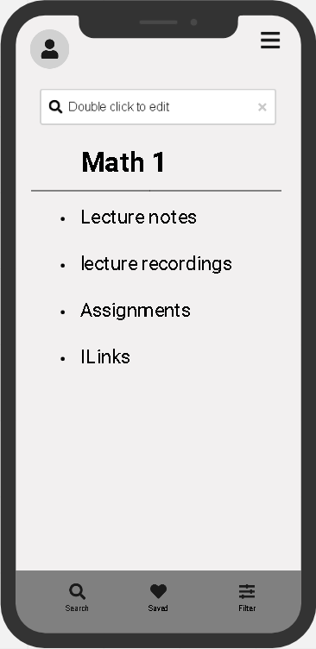
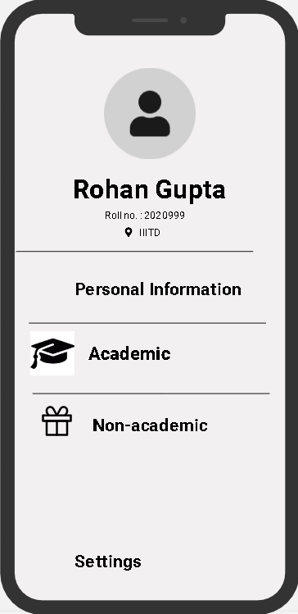
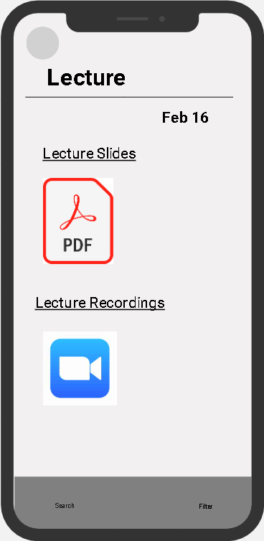
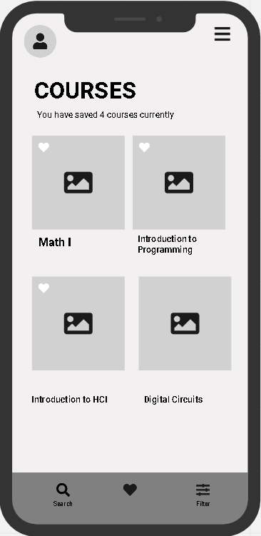
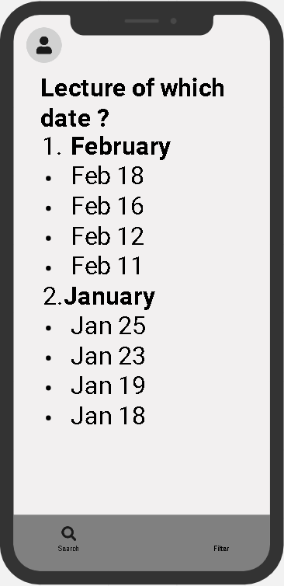

Slide 22
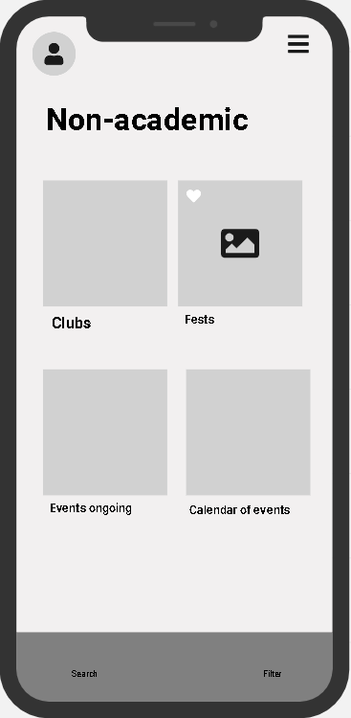
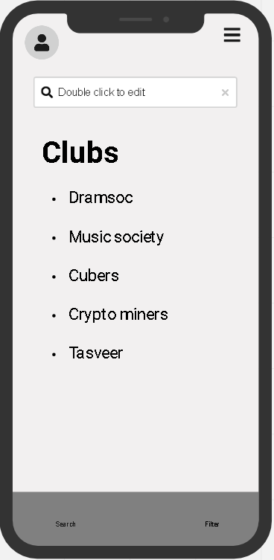
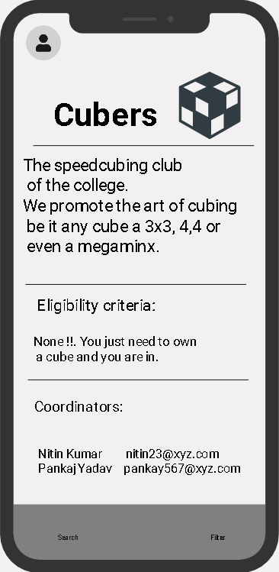

Slide 23
HIGH FIDELITY
https://www.figma.com/proto/LWiJG2Vjbbwa0m7l6rgoWG/infollege?node-id=1%3A2&scaling=scale-down&page-id=0%3A1

Slide 24
Prototype Evaluation

Slide 25
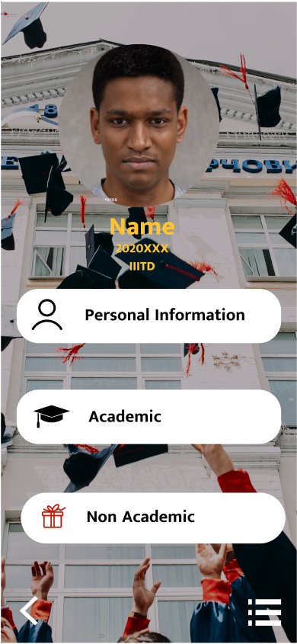
Homepage
The background image is distracting.(This issue also exists further in our prototype)
Could change the background to something soothing.(This solution applies to all places where this issue has been reported)
Click on ‘Academic’ to go to stuff related to academia

Slide 26
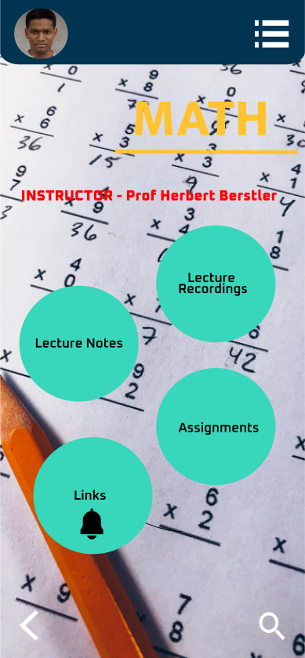
Specific Course Page
Click on “lecture notes” to get the notes of a specific lecture.
Could introduce tooltip for the notification feature and give some visual feedback when clicked.
Click on the bell icon to turn on notifications for the next lecture
The notification feature could have been highlighted, it is possible that the user is unaware of its existence.
Back button to go to the previous page

Slide 27
Thank You

